Slide 1
CIS 55 – iOS Programming
Manish Goel

Slide 2
Lecture Objectives
Explore our “Hello World” app in more detail
“Hello World !!”
Hands-on Lab

Slide 3
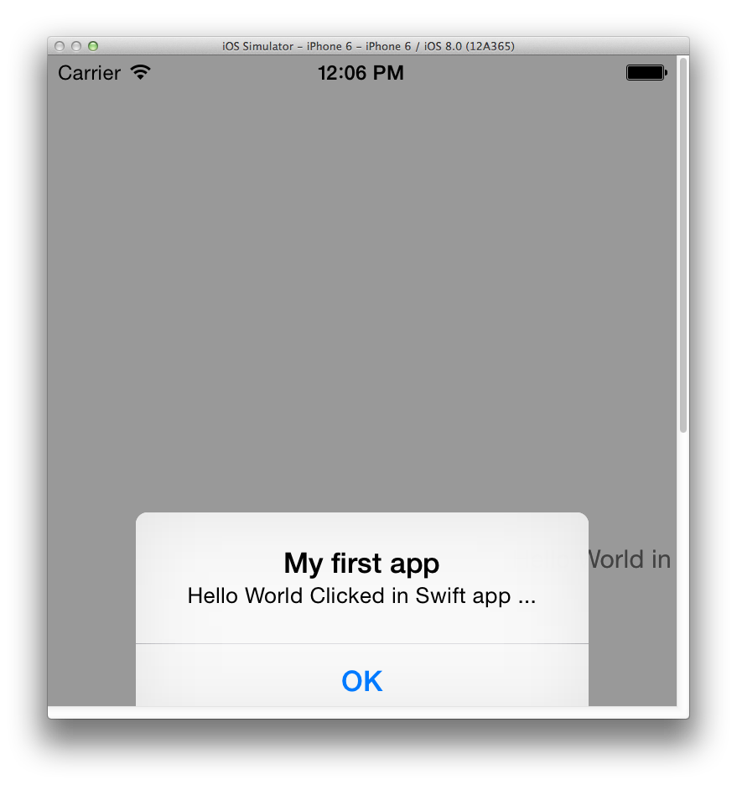

Slide 4
“Hello World” dissection
Created a “Single Page View” app using the “iOS” wizard –
Xcode created a basic “project” for us with multiple files
5 main building blocks of the project that we need to know about:
AppDelegate.swift – this is the “object” that monitors app events for the iOS and sets up appropriate app behaviors
ViewController.swift – this is the “object” that provides functionality to your UI
Main.Storyboard – this is the “object” that allows you to create the UI with minimal code
LaunchScreen.xib – this is the “object” that is shown when your app is started
Info.Plist – this is a list of things that your app discloses to the iOS to work

Slide 5
“Hello World” dissection - 2
Added a button to the default view on the Storyboard and changed its label
Added an Outlet to the button – a property of the button that allows data to be passed between the user and the view
Added an Action to the button – a property of the button that allows interactions to be passed between the user and the view
Coded the Action of the button to show an Alert indicating the response
Alert itself is another view

Slide 6
Recap
iOS Programming is Visual (and Xcode gives good hints):
Apps are designed top-down, i.e. UI first, code later
UI is designed by putting UI elements on a Storyboard
UI elements are predefined controls provided by Xcode
Once UI looks good, define what those controls will do
Outlets and Actions
Outlets allow data to be interchanged between the user and app – I/O
Actions do some work in relation to some event

Slide 7
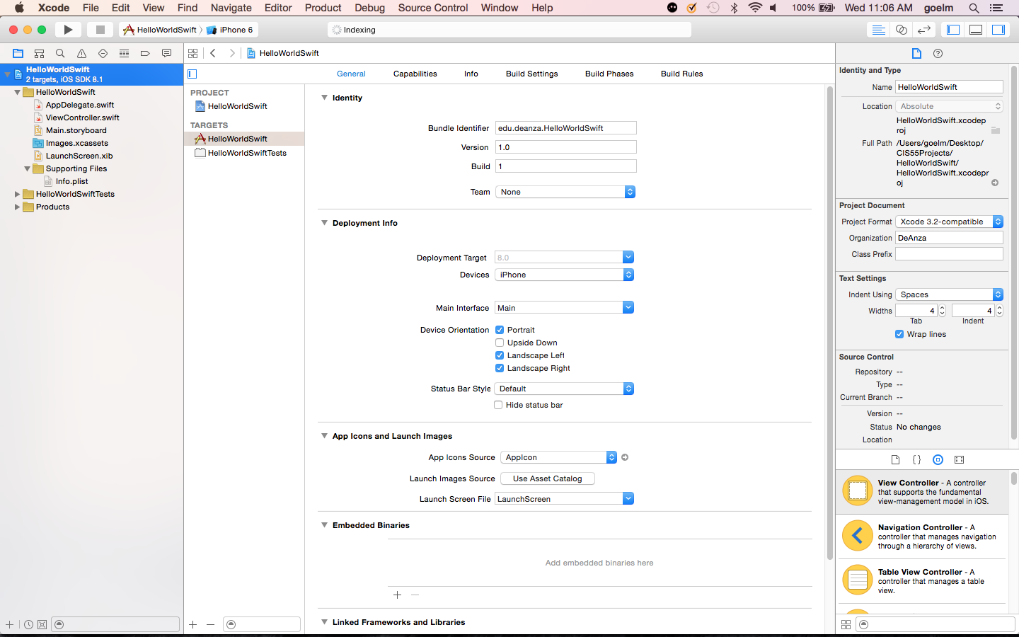
Toolbar
Utilities
Navigator
Editor

Slide 8
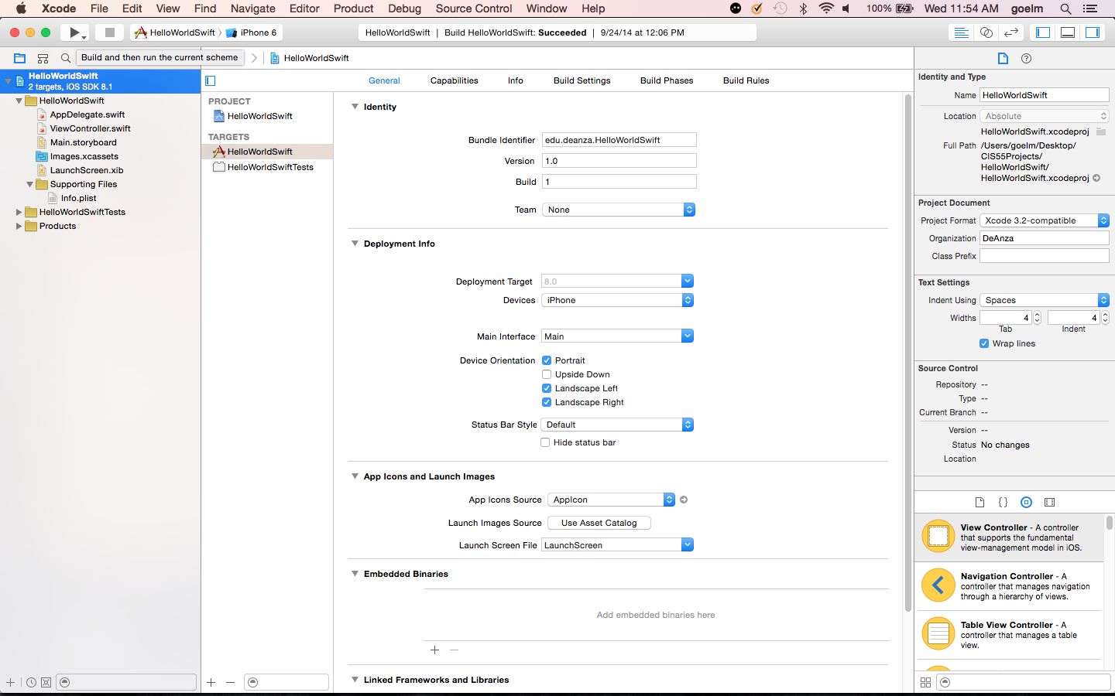
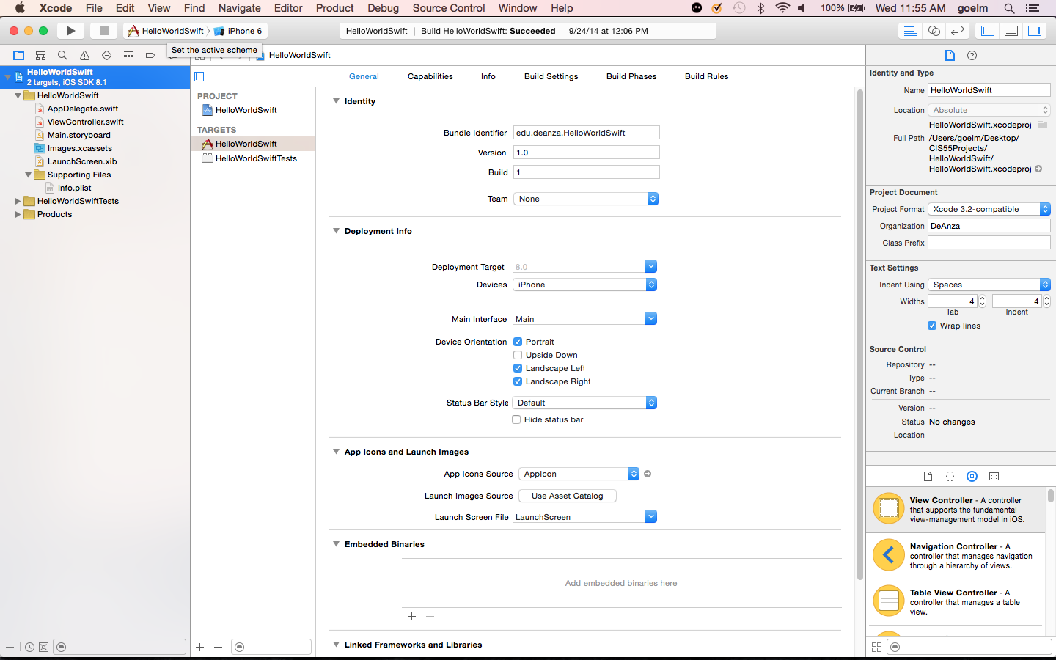
Compile and run/stop the current project for the chosen simulator
Choose the desired simulator for the project

Slide 9
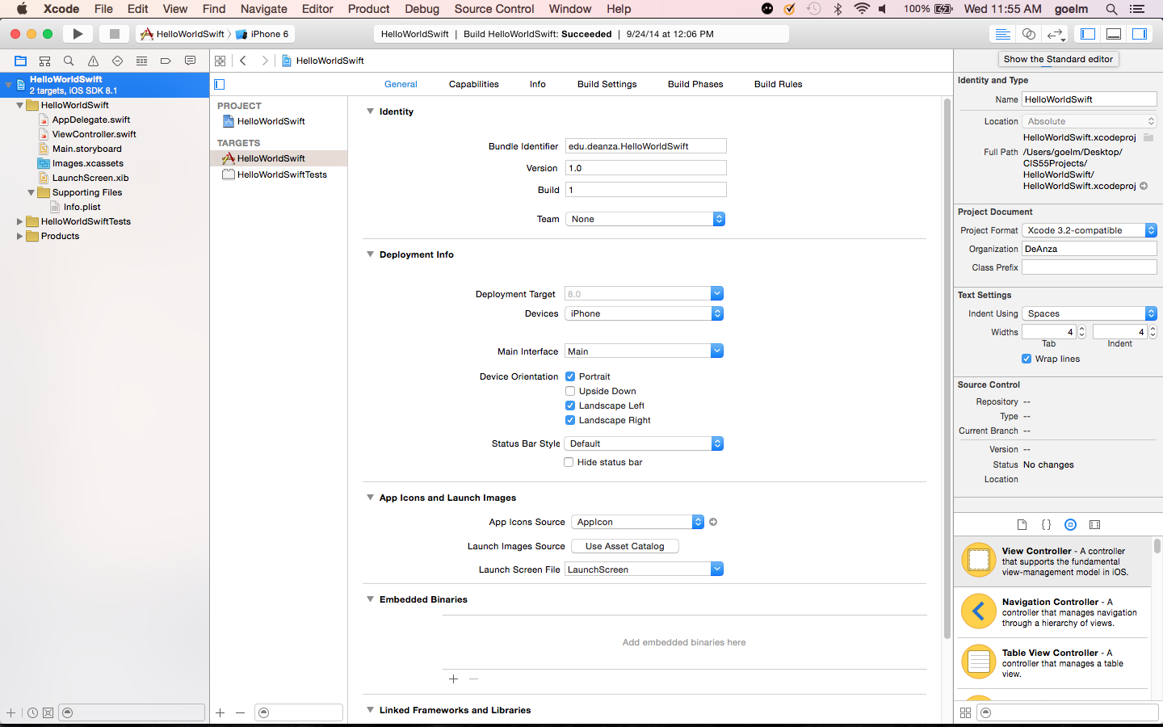
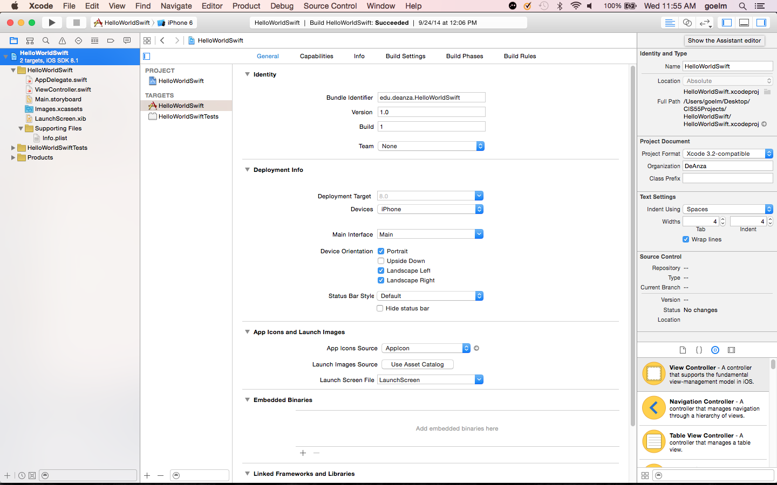
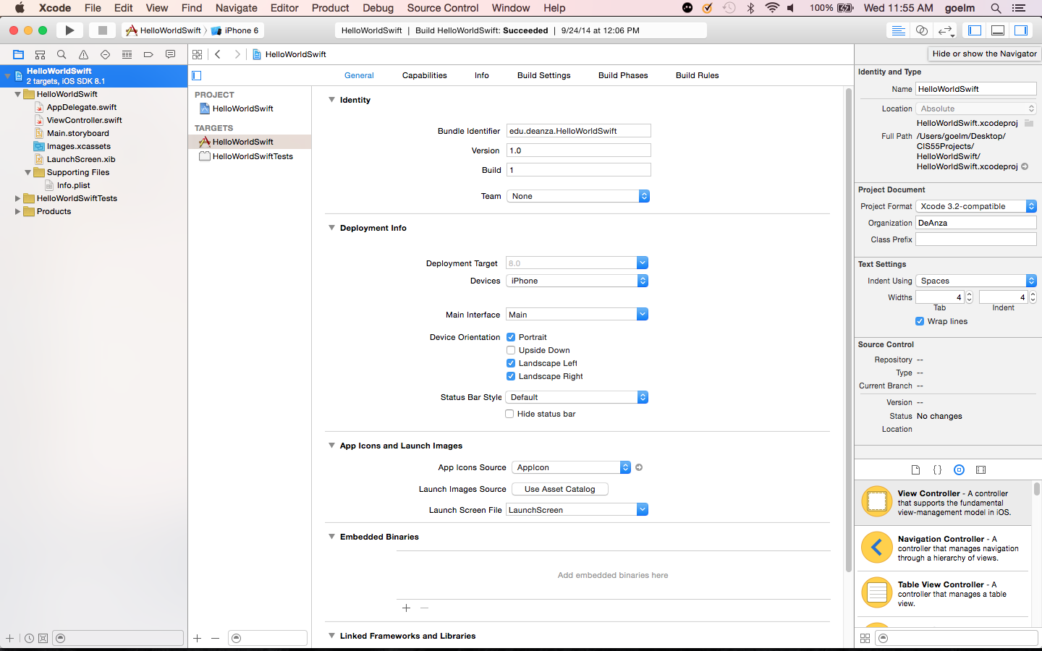


Slide 10
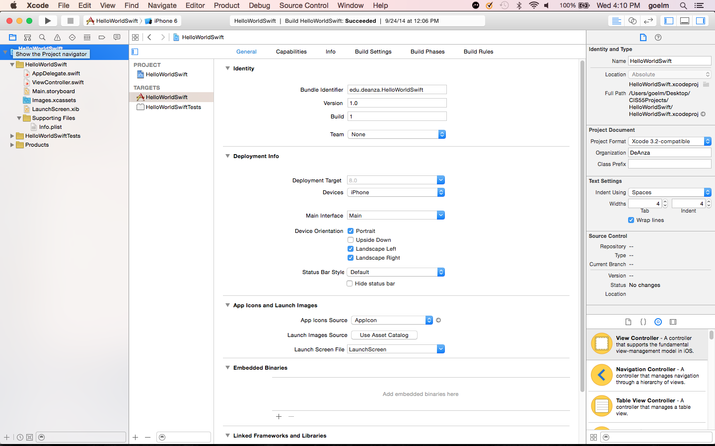
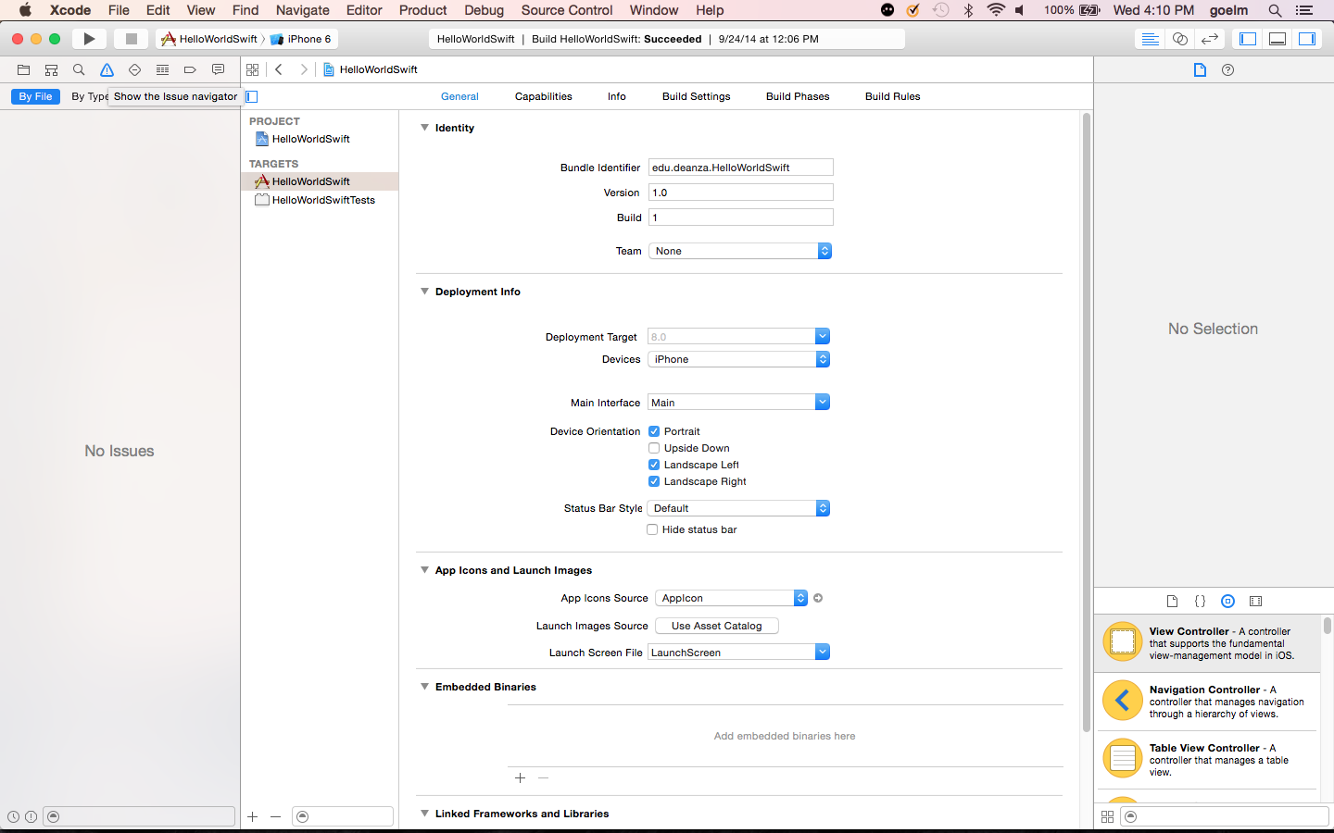

Slide 11
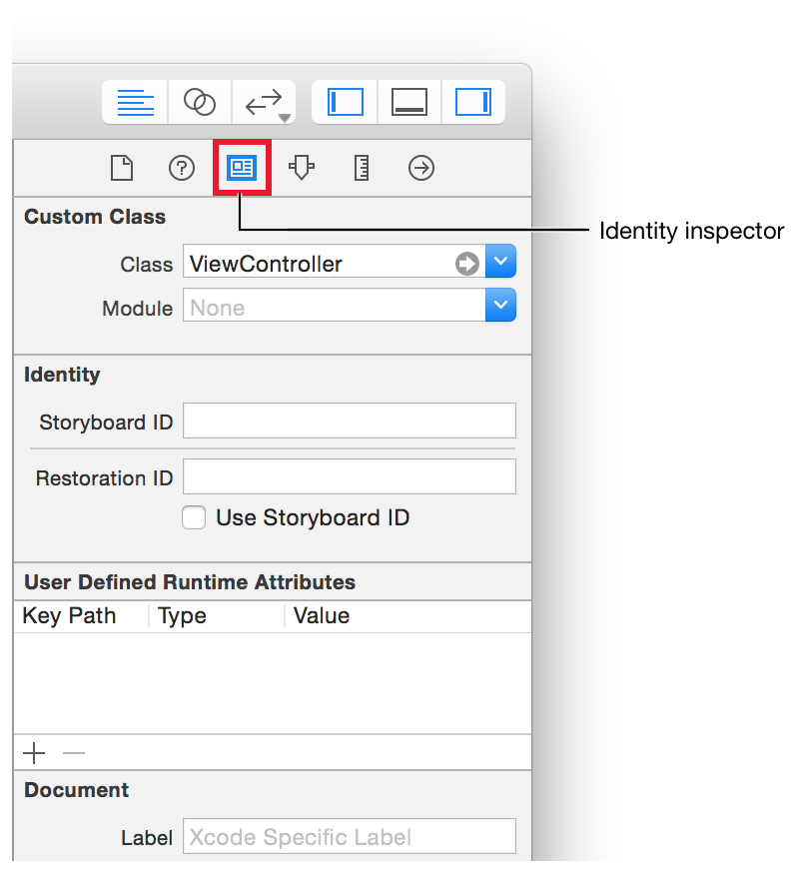
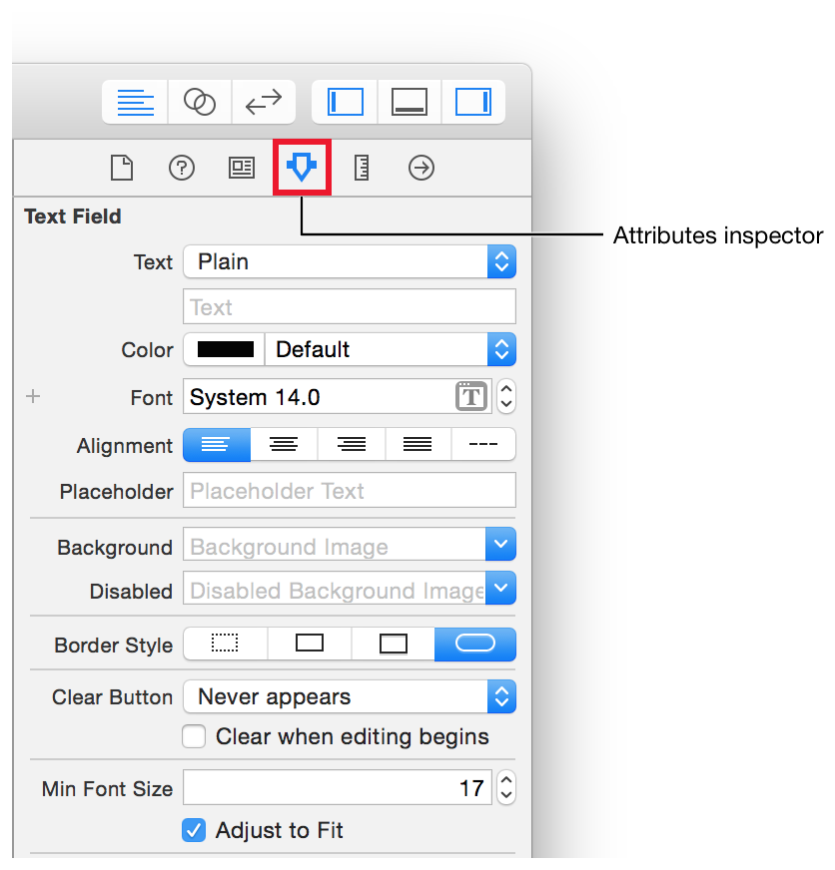

Slide 12
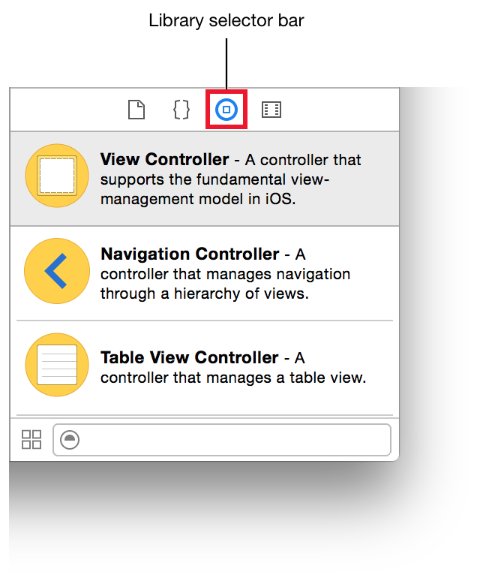
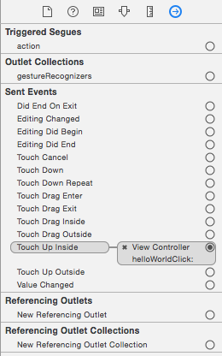
Connections inspector

Slide 13
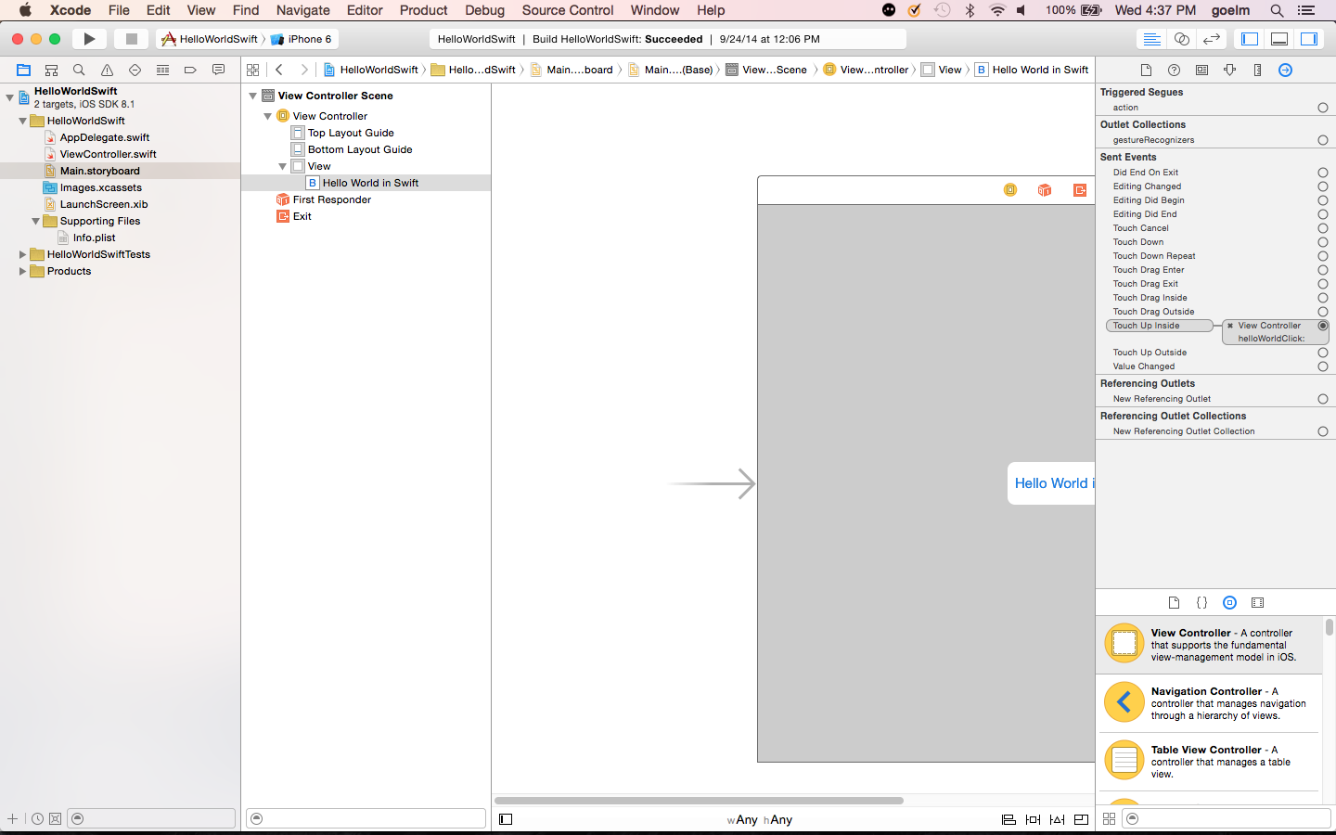
Scene
Navigator
Storyboard
Scene

Slide 14
Key iOS concepts
Objects are building blocks for Apps
Objects have attributes (or properties) and behaviors (or actions).
Classes are blueprints (templates) for Objects
Class describes the attributes and behaviors of the object for programmers and code to understand and act with / upon
Objects are instances of Classes, i.e. a class can create more than one object
Objects communicate through Messages
Objects hide their attributes and expose their behaviors so other objects can only interact with them by passing messages to them
Protocols define Messaging Contracts
A protocol is needed for other objects to know how to pass messages to a given object – similar to an Application Programming Interface (API)

Slide 15
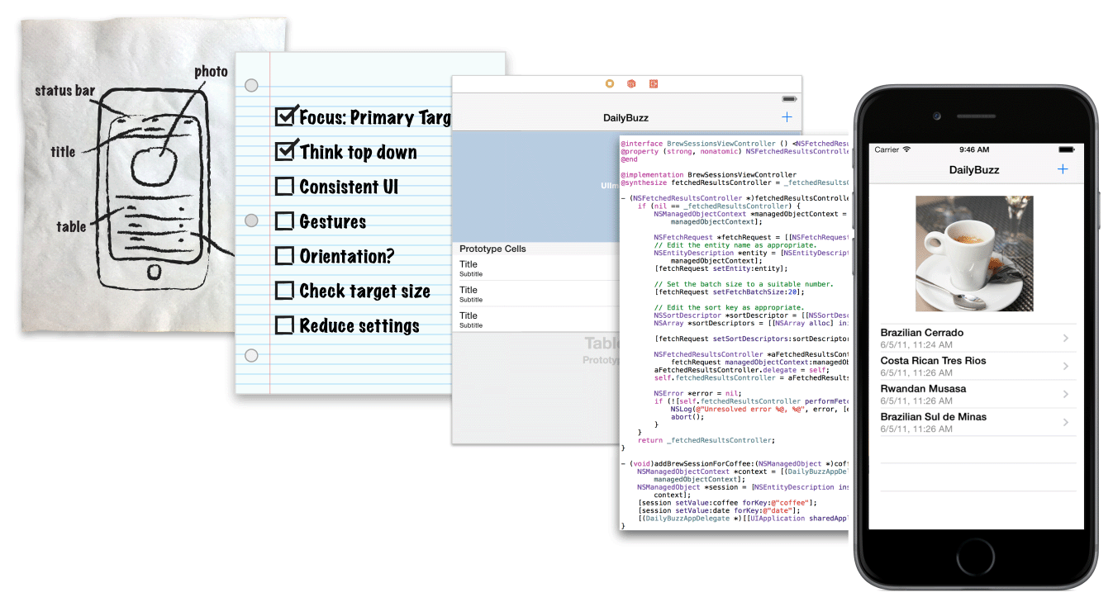
Designing your iOS app
Define your concept:
Who is your audience?
Kids vs Adults
Consumer vs Business
What is your app’s purpose?
Try to solve a single or specific problem
What content will your app show?
This will be manifested in your user interface

Slide 16
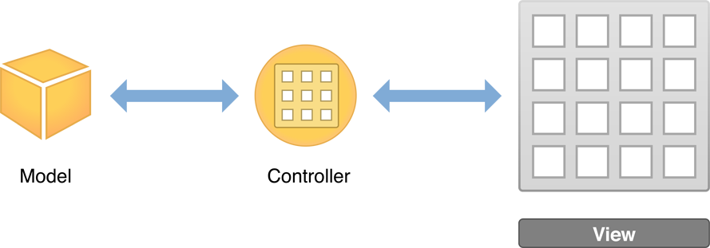
Key iOS concepts - 2
Apps follow the Model-View-Controller (MVC) architecture
Model is the data or the persistence scheme of the app
View is the UI of the app for the user
Controller provide the interaction between the two:
by populating the data into the views or saving the data from the views, and
by letting the views respond to user actions

Slide 17
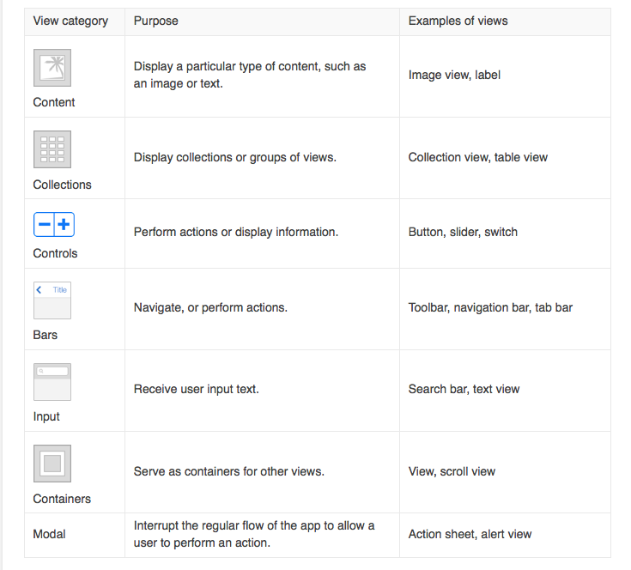
Key iOS concepts - 3
Views are “windows” objects that have a hierarchy
Views can have related (children) views that extend their functionality
Views can contain other views (sub-views) that need to interact together
View Controllers manage the interaction of the views amongst themselves and with the user

Slide 18
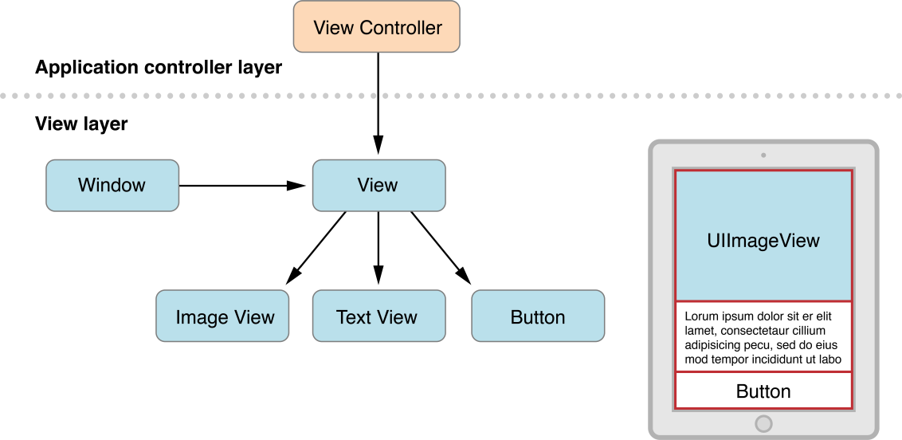
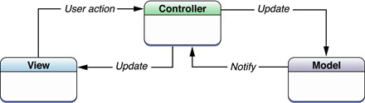

Slide 19
What is Object Oriented Programming?
Simplistic Example – in this classroom:
Human, Clothes, Furniture, Room are different type of objects
Human object can be defined by a class called ‘human’
Human object has properties – one head, two eyes, two hands, two legs etc.
Human object has behaviors – can walk, can talk, can eat etc.
A “Boy” or a “Girl” extends the functionality of a “Human” – demonstrating “is-a kind of” relationship
“Boy” or “Girl” also overrides the functionality of “Human” – specialized biological characteristics
So the “boy” and “girl” class definitions are “sub-class”es of the “human” class
Each of you are an “instance” of either the “boy/Boy” or “girl/Girl” class/object but all of you are an “instance” of the “human/Human” class/object
Similarly, you can derive “is-a kind of” relationship for various clothes or furniture in the room
The clothes on one of you determines the “contains” relationship between the Clothes and Human objects
Or, the furniture in this room determines the “contains” relationship between the Room and Furniture objects

Slide 20
iOS App Development Paradigm
iOS App Development Process – an Object Oriented approach
An iOS app is and is built from a network of Objects
You as programmer use existing objects or create new ones
When you use existing objects – you create composition hierarchies of objects – “contains” relationship
When you create “brand new” objects – you define properties and behaviors
New objects can be created by extending or overriding functionality of existing ones – you define inheritance hierarchies of objects – “is-a kind of” relationship
Objects are defined as classes in code and represented as interface and implementation
Properties are data about the object that is “encapsulated”
Behaviors are methods to allow an object to “receive messages” and act on them
Your app’s network of objects allows messages to be passed between them using Protocols

Slide 21
OOP in iOS – What it means to me
Design the app using existing objects or controls :
UIViewController, UITableViewController, UITableView, UITableViewCell etc.
UITableViewController contains UITableView which contains UITableViewCell etc.
Existing objects can be customized as we desire by adding properties and implementations for methods
Existing objects can also be used as is –default version
Our storyboard is also an object – it contains Scenes and Scenes are connected like a network
When more than one scene is added, navigation controller and new view controllers are needed
Protocols determine how our extended objects pass messages between themselves
Segues are protocols to pass messages between Scenes to crate our network inside the app

Slide 22
References
Start Developing iOS apps today
https://developer.apple.com/library/ios/referencelibrary/GettingStarted/RoadMapiOS/index.html#//apple_ref/doc/uid/TP40011343
An Absolute Beginners Guide to Swift
http://blog.teamtreehouse.com/an-absolute-beginners-guide-to-swift
Swift Tutorial – simple iOS app by Ray Wenderlich
http://www.raywenderlich.com/74904/swift-tutorial-part-2-simple-ios-app
Swift Tutorial Series by Jameson Quave
http://jamesonquave.com/blog/tutorials/

